Slide 1
Objects in JavaScript
Mirzoulugbek Yusupov

Slide 2
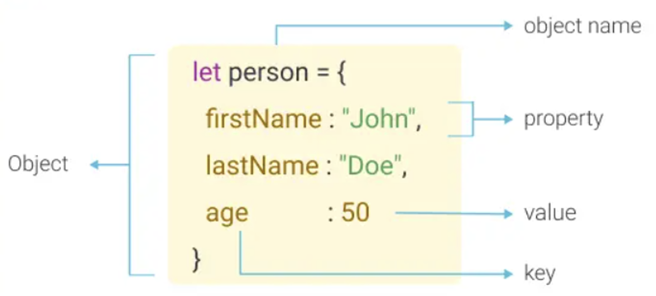
Objects in JavaScript
An object is a collection of key-value pairs used to store structured data.
Objects are mutable, reference-based, and allow dynamic properties.
Everything in JavaScript (except primitives) is an object.

Slide 3
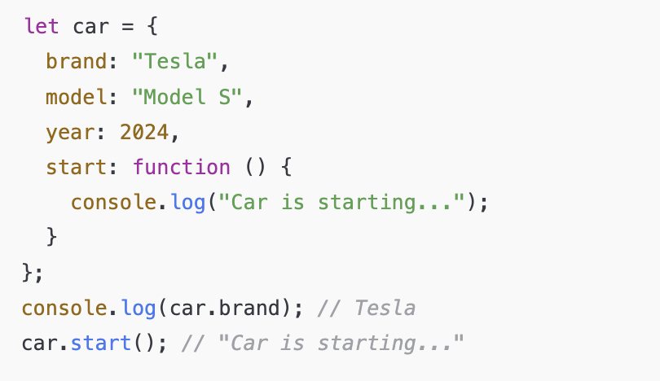
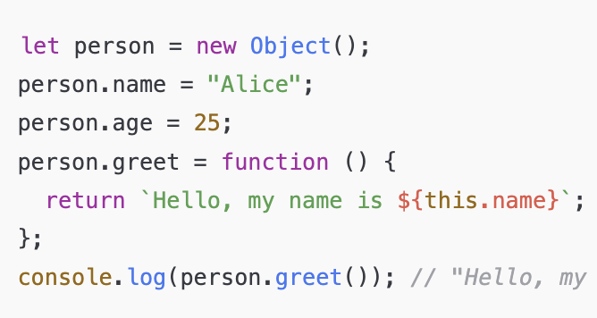
Ways to Create Objects
Object Literal ({})
Directly defines key-value pairs inside {}.
Does not use constructors or prototypes explicitly.
Useful for static or single-instance objects.
Best for creating simple object with pre-defined values
2. Using new Object()
Creates an object using JavaScript’s built-in Object constructor.
Equivalent to object literals but allows dynamic property assignment.
Best creating an empty object and populate it dynamically.

Slide 4
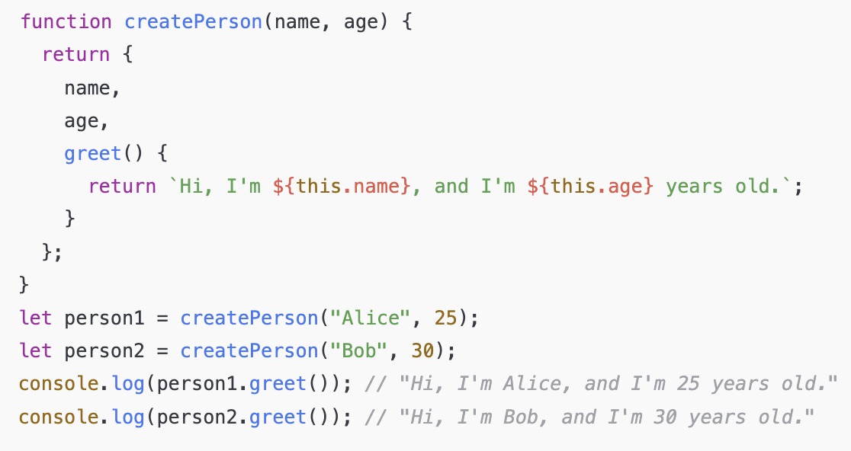
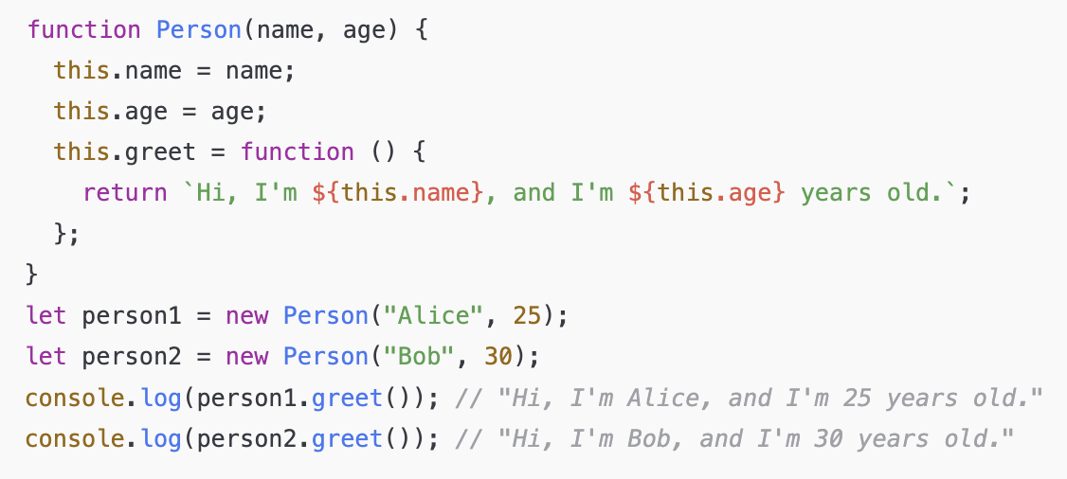
Ways to Create Objects
3. Factory Function
Uses a function that returns an object.
Creates multiple objects with similar properties and methods.
No need for new keyword.
Best when you need multiple similar objects without using classes.
4. Constructor Function
Uses a function and this to create objects.
Requires the new keyword.
Supports inheritance via prototype.
Best for creating multiple objects with similar structure and behavior.

Slide 5
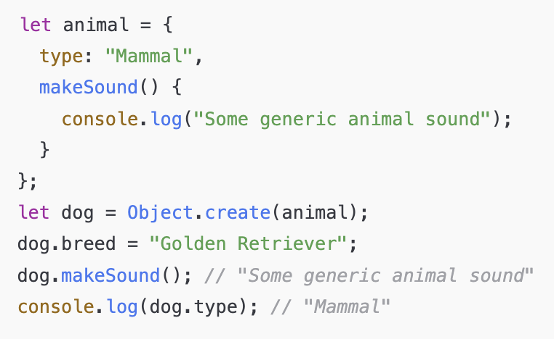
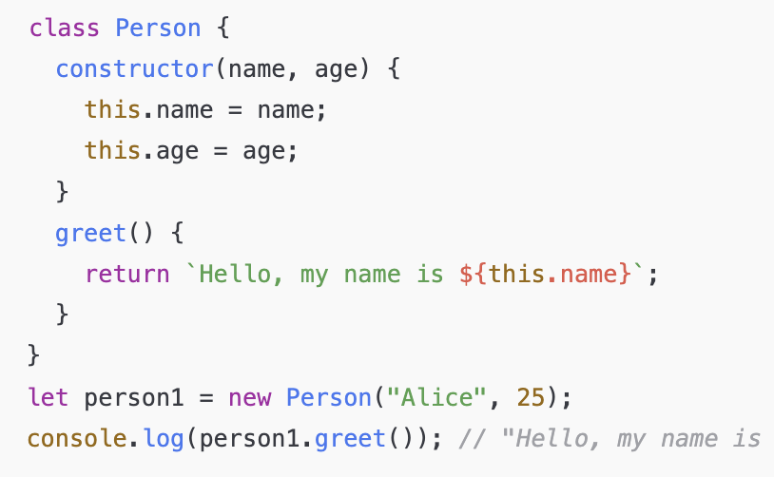
Ways to Create Objects
5. Using Object.create(prototype)
Creates an object with an explicitly defined prototype.
Good for prototype-based inheritance.
When you want to create objects that inherit from a predefined prototype.
6. Using ES6 class
Modern way to create objects.
Uses constructor for property initialization.
Supports inheritance using extends.
When you need a structured object-oriented approach.

Slide 6
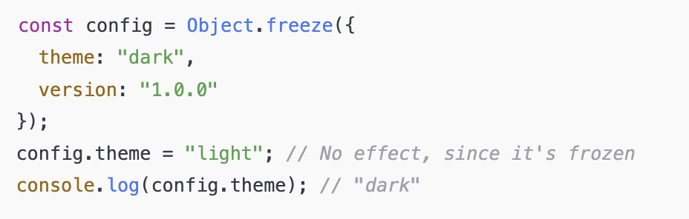
Ways to Create Objects
7. Singleton Object (Object.freeze())
Creates a single instance that cannot be modified.
Prevents adding, removing, or modifying properties.
When defining global constants or configurations.

Slide 7
Comparison
Method | Mutable | Performance | Syntax | Uses new
Object Literal ({}) | ✅ Yes | ⚡ Fastest | { key: value } | ❌ No
new Object() | ✅ Yes | ⚡ Fast | new Object() | ✅ Yes
Object.create() | ✅ Yes | 🔄 Mid | Object.create(proto) | ❌ No
Class (ES6) | ✅ Yes | 🚀 Optimized | class ClassName {} | ✅ Yes
Factory Function | ✅ Yes | ⚡ Fast | function createObj() {} | ❌ No
Object.freeze() | ✅ Yes | ⚡ Fast | function Constructor() {} | ❌ No
Constructor Function | ❌ No | 🚀 Optimized | Object.freeze(obj) | ✅ Yes

Slide 8
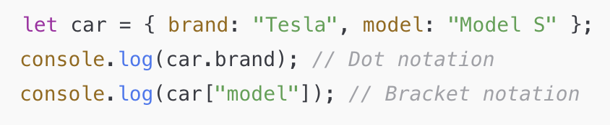
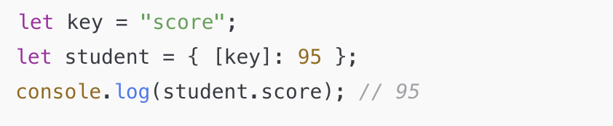
Object Properties & Accessors
Dot Notation vs Bracket Notation
Computed Properties

Slide 9
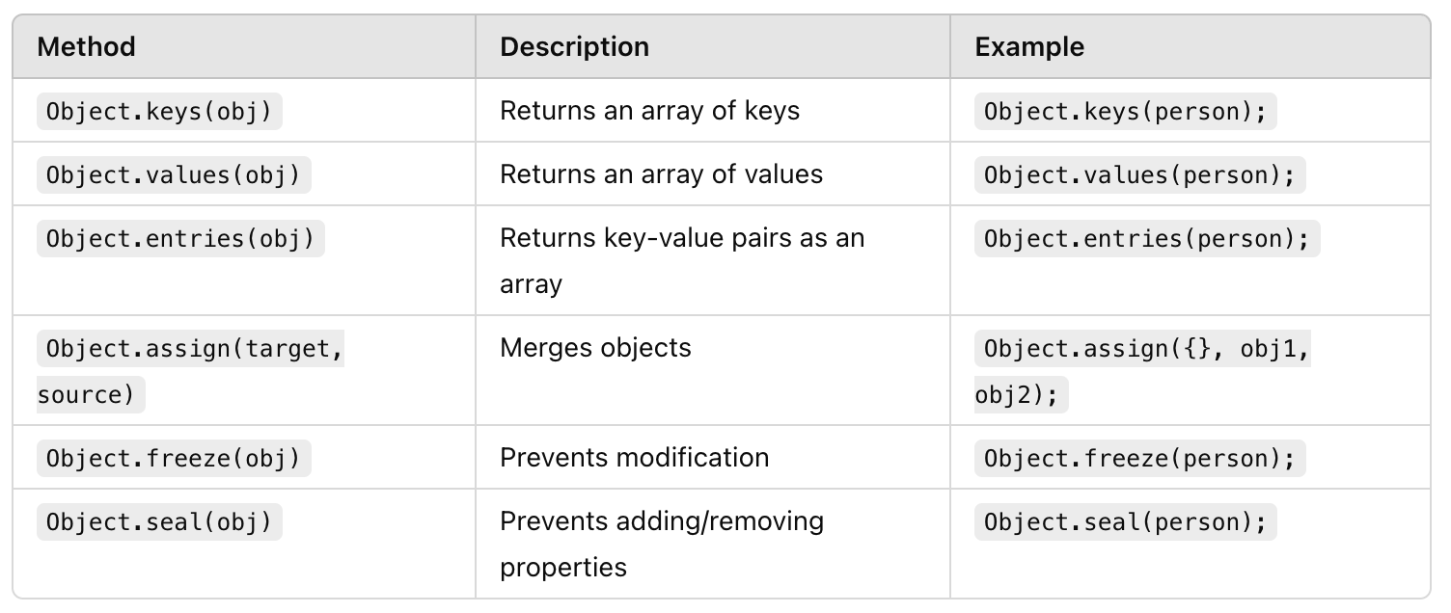
Object Methods (Object.*)
Common Methods and Usage

Slide 10
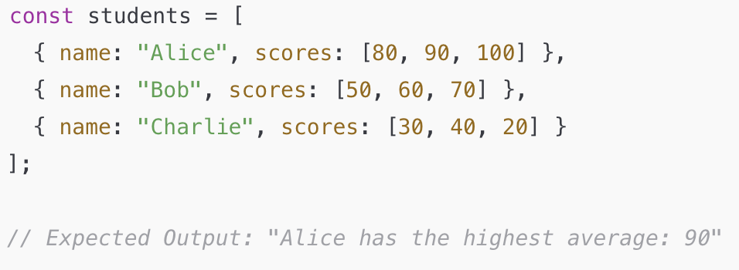
Practice
Challenge 1 - Student Grade Management System
You have a list of students, each with their name and an array of scores.
Calculate the average score of each student
Determine if the student has passed (avg ≥ 50)
Find the top-performing student

Slide 11
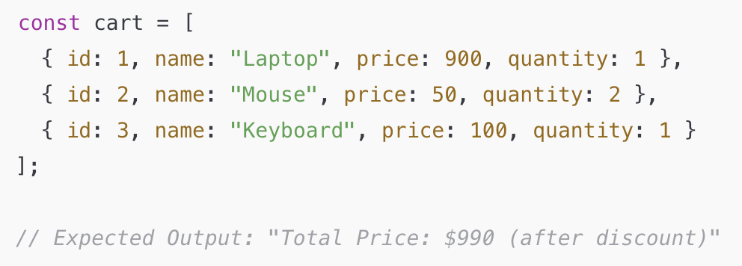
Practice
Challenge 2 - E-Commerce Cart System
You have an array of cart items where each item is an object containing id, name, price, and quantity.
Calculate the total price of all items
Apply a 10% discount if total price is above $100
Find the most expensive item

Slide 12
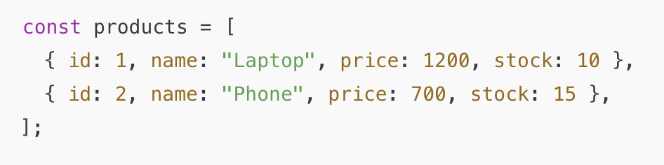
Practice
Challenge 3 - Product Inventory Management
Create an array of product objects (each with id, name, price, and stock).
Add a new product (addProduct).
Update stock of a product (updateStock).
Delete a product by ID (deleteProduct).
Find a product by name (findProduct).
Variation: Use higher-order functions (map(), filter(), reduce()) to manipulate the product list.

Slide 13
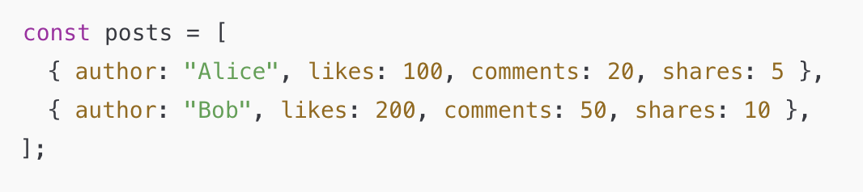
Practice
Challenge 4 - Social Media Post Analytics
Define an array of post objects, each with author, likes, comments, and shares.
Implement a function to find the most liked post.
Implement a function to calculate total engagement (likes + comments + shares) for all posts.
Variation: Store comments as an array of objects (with user and message).

Slide 14
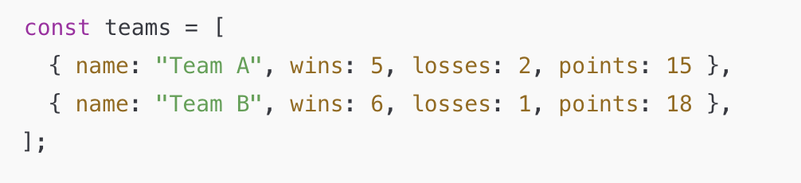
Practice
Challenge 5 - Sports Tournament Leaderboard
Define an array of team objects, each with name, wins, losses, and points.
Implement a function to sort teams by ranking.
Implement a function to find the best-performing team.
Variation: Add goal statistics (goalsScored, goalsConceded).

Slide 15
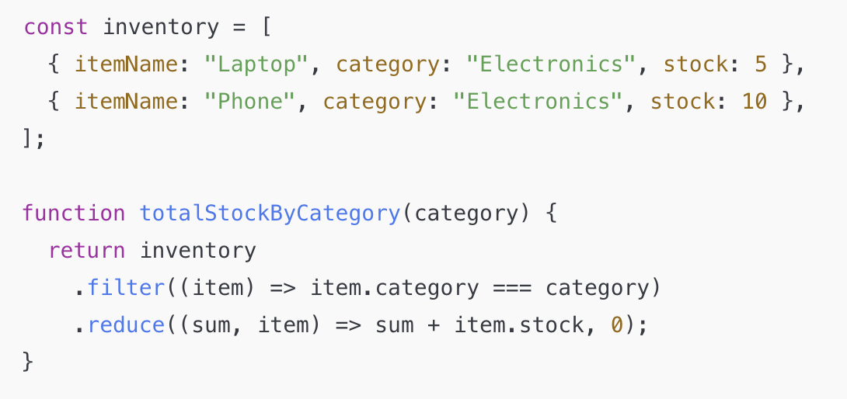
Practice
Challenge 6 - Warehouse Stock Management
Create an array of inventory objects (itemName, category, stock).
Implement a function to calculate total stock per category.
Variation: Implement an alert system for low-stock items.

Slide 16
Thank You

